Slide 1
Loss Functions in Tenser Flow
By Aymen Tariq

Slide 2
What is a loss Function?
A loss function is a means of assessing the performance of a model and also helps in optimizing it
Helps in knowing the deviation of the predicted values from the actual ones
Not easily explainable by humans

Slide 3
Loss Functions for Regression
In regression, the output can be any real number.
The loss functions for regression are given below:
Mean Absolute Error
Mean Squared Error

Slide 4

Mean Absolute Error
Measures the absolute difference between predicted and actual values
Non-negative output
Takes the mean of difference of all the training examples
$$\frac{1}{m}\sum_{i=1}^{m}{}|{\overset{^}{y}}_{i}–y_{i}|$$
Where m is the number of training examples, ${\overset{^}{y}}_{i}$ and $y_{i}$ represent the predicted and actual values respectively.

Slide 5
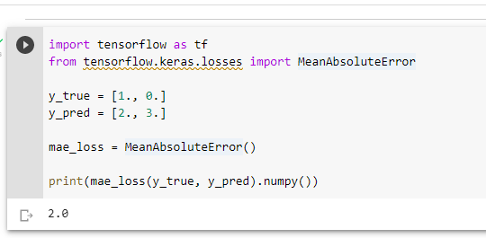

Mean Absolute Error
Given below is a sample code for MAE with output
$$\frac{1}{2}(|2−1|+|3−0|)=\frac{1}{2}(4)=2$$

Slide 6

Mean Squared Error
Measures the difference between predicted and actual vales like the Mean Absolute Error but it takes the square of differences instead of absolute and then mean
Helps with large number of small errors
Less outliers than MAE because of square
Non-negative output
$$\frac{1}{m}\sum_{i=1}^{m}{}({\overset{^}{y}}_{i}–y_{i})^{2}$$

Slide 7
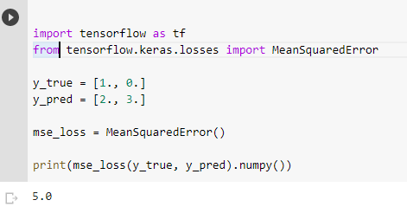

Mean Squared Error
Given below is a code for MSE
$$\frac{1}{2}[(2−1)^{2}+(3−0)^{2}]=\frac{1}{2}(10)=5$$
Here, we can see that the error rate for 2nd training with MAE is 75% while with MSE is 90%.

Slide 8
Loss Function for Classification
In classification, the output involves small and discrete set of numbers. It is a probability vector for each category.
Given below is a loss function for classification
Cross-Entropy

Slide 9

Cross-Entropy
It is the difference between the probability distributions of all categories
$$−\sum_{i}{}P\left(X=x_{i}\right)\log{Q\left(X=x_{i}\right)}$$
Where P represent the probability provided by the training data and Q is the probability predicted by the model.
P=1 for correct class, p=0 for every other class
Q lies between 0 and 1
$$\text{categorical} \text{cross} \text{entropy}=–log⁡p_{gt}$$
where $p_{gt}$ represents the model-predicted probability of actual class for that specific sample.

Slide 10
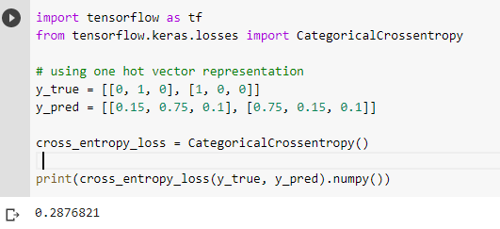
Cross-Entropy
Given below is a sample cross-entropy code with output

